Slide 1
Forecasting Inflation Rate in the United States
December 3rd 2015
NagaShrikanth Ammanabrolu, Nikhil Soman, Chandan Rama Krishna
676837954 663570371 670288569

Slide 2
Table of contents
Primary Objectives
Inflation Rate and CPI
Datasets collection and cleaning
Modeling Procedure
Forecasting & Plotting the graphs
Results
Conclusion

Slide 3
Primary objectives
To make use of the readily available Inflation rate in the United States, given in terms of CPI and use it to forecast for the next 12 months.
To develop an adequate model to predict the values of the Inflation rate in the future.
The influence of CPI and other factors on the inflation rate.

Slide 4
INFLATION RATE AND CPI
Inflation Rate is the sustained increase in the general level of prices for goods and services.
CPI is the measure of price changes in consumer goods and services such as gasoline, food, clothing and automobiles.
The CPI measures price change from the perspective of the purchaser.
Demand-Pull and Cost-push are the two major theories on the Inflation rate which are universally accepted.
Source: Bureau of Labor Statistics

Slide 5
Datasets: Collection and cleaning
The primary source of data for this project was obtained from the US Inflation Calculator.
The data set used for this project is collected on a monthly basis, between the periods of January 1990 to December 2014.
Inflation rates back in the early 1900’s do not affect present inflation rates, and so, we’ve cleaned the data and extracted parts of it required.

Slide 6
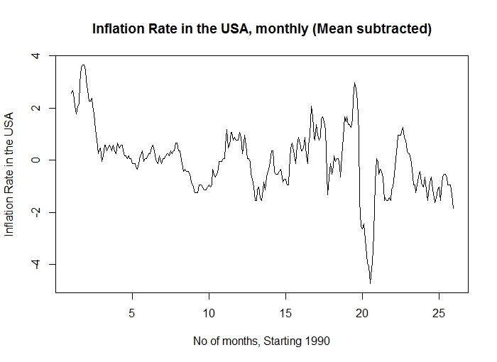
Modeling procedure
Y (t) = F (t) + X (t)

Slide 7
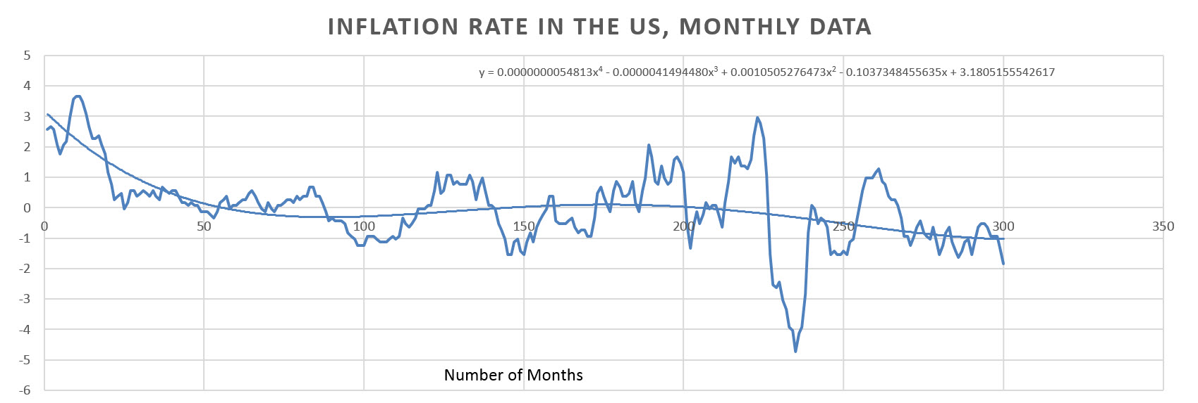
Modeling procedure
Trend analysis and F-Tests
The system equation is given by:
y = 0.0000000054813x⁴ – 0.0000041494480x³ + 0.0010505276473x² – 0.1037348455635x + 3.1805155542617

Slide 8
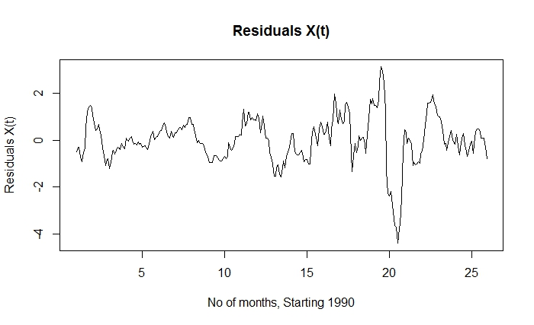
Modeling procedure
Residuals and ARMA Modeling
Plotting Residuals as a Time Series using R

Slide 9
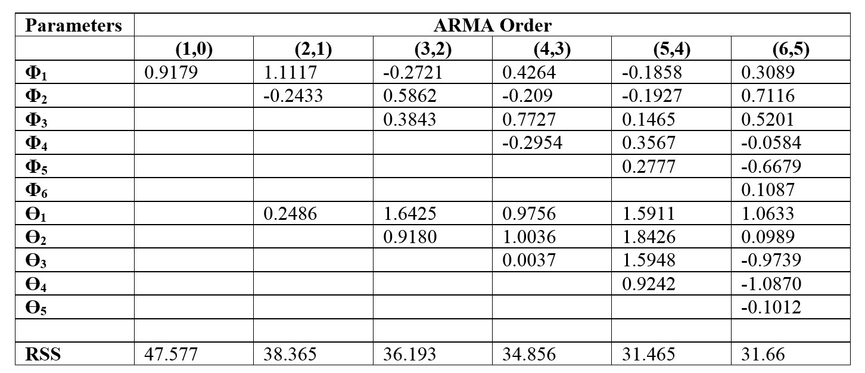
Modeling procedure
Residuals and ARMA Modeling
Using F-Test and ARMA (n, n-1) modeling, the ARMA (5, 4 ) model is found adequate and is summarized below .

Slide 10
Modeling procedure
Characteristic Roots and Parsimonious model
The adequate ARMA (5,4) model is represented by the equation:
λ⁵ – ϕ₁ λ⁴ – ϕ₂ λ³ – ϕ₃ λ² – ϕ₄ λ¹ – ϕ₅ = 0
Whose characteristic roots are found out to be:
λ₁ = 0.8593
λ_{2,} λ₃ = -0.560066 ± 0.354404i
λ_{4,} λ₅ = 0.0374667 ± 0.856854i

Slide 11
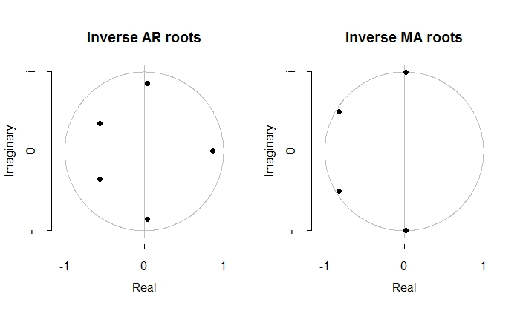
Modeling procedure
Characteristic Roots and Parsimonious model
From the real and complex conjugate pairs of characteristic roots,
no particular trend or seasonality is observed in the data.

Slide 12
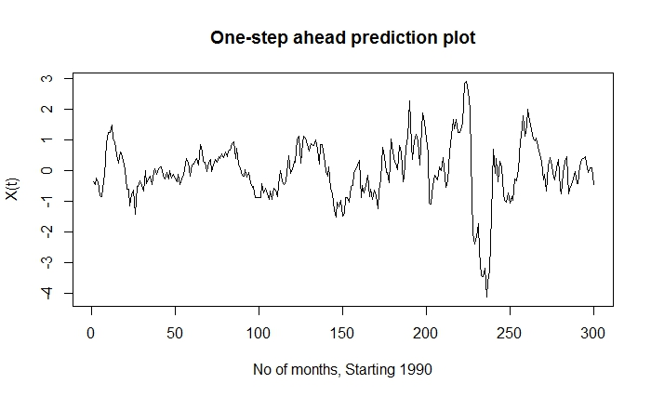

FORECASTING & PLOTTING THE GRAPHS
One-Step-Ahead prediction
The X(t) at one-step ahead prediction or $\hat{X}$_{t}(1) is obtained from the equation
described below.
$\hat{X}$_{t}(1) = ϕ₁X_{t} + ϕ₂X_{t-1} + ϕ₃X_{t-2} + ϕ₄X_{t-3} + ϕ₅X_{t-4} - ϴ₁a_{t} - ϴ₂a_{t-1} - ϴ₃a_{t-2} - ϴ₄a_{t-3} + a_{t+1}

Slide 13
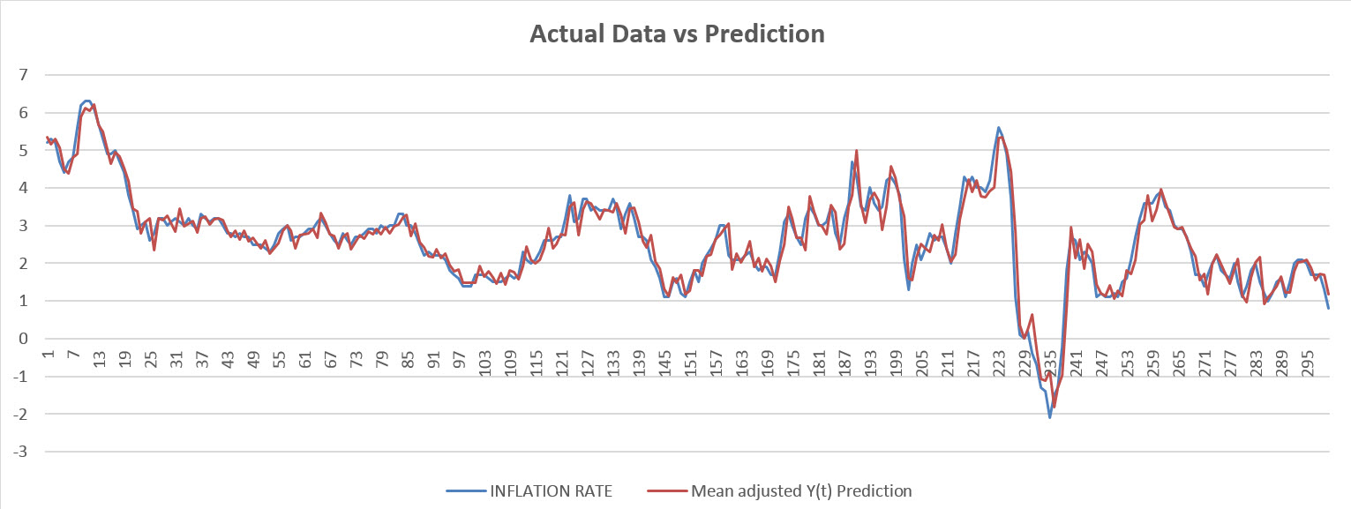
FORECASTING & PLOTTING THE GRAPHS
Plotting the actual data versus the predicted one-step ahead data

Slide 14
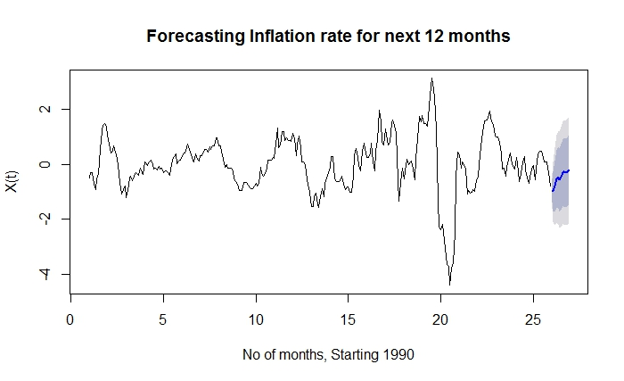
FORECASTING & PLOTTING THE GRAPHS

Slide 15
results
The CPI is just one indicator of the Inflation rate, among many other factors.
Since the present values of the Inflation rate are independent of the previous values of CPI, the stochastic nature of the dataset is bound for some uncertainties.
A slack economy, drop in oil prices and other energy products in past year, rise of the value of dollar over the past year and other factors led to a drop in Inflation rate in the United States for the first half of 2015.

Slide 16
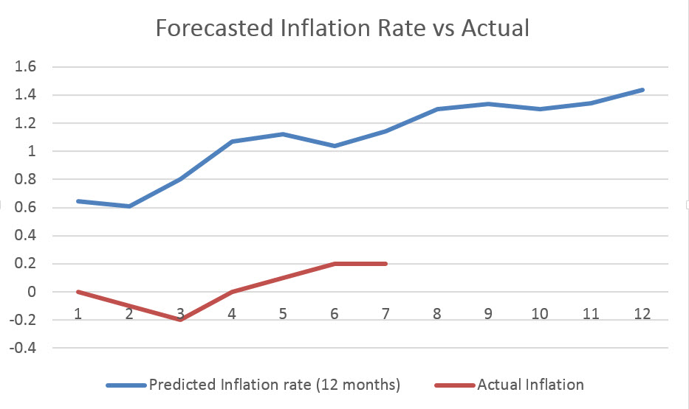
results
Inflation (Next 12 months) | Actual Inflation Rate
0.645586163 | -0.1
0.60711369 | 0
0.800029497 | -0.1
1.070046521 | -0.2
1.12325667 | 0.1
1.035480845 | 0.2
1.142115452 | 0.2
1.300218529 | -
1.335171203 | -
1.301532768 | -
1.3425636 | -
1.437709248 | -

Slide 17
CONCLUSION
Our stochastic modeling process has been able to adequately analyze and forecast the Inflation Rate in the United States.
Our method yields the closest and best approximation for the given dataset.
The stochastic nature of the dataset and the number of factors influencing the Inflation rate in the United States is illustrated by the deviation of the predicted values from the actual values during the first quarter of 2015.

Slide 18
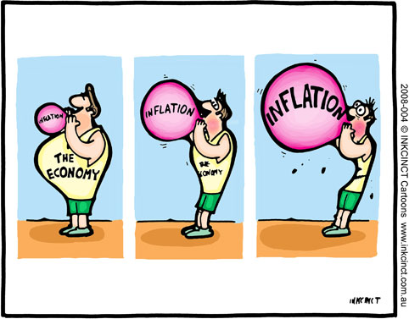
ANY QUESTIONS?

